Slide 1
Modern Analytics Academy “Vignettes”
Follow up to Modern Analytics Academy: https://aka.ms/maa
Topical sessions that addresses:
New features and how to use them
Frequent questions we receive
Updates to a previous session

Slide 2
Modern Analytics Academy “Vignettes”
Synapse Data Explorer
https://aka.ms/maa
Devanshi Thakar
Cloud Solution Architect

Slide 3

Telemetry - A key data for Digital Transformation
50B
IoT
175ZB
Logs
Events
connected devices by 2030
Time Series
Click Stream
total amount of data by 2025
Connected Devices
SIEM
Smart Buildings
Security
Smart Factories
Historians

Slide 4
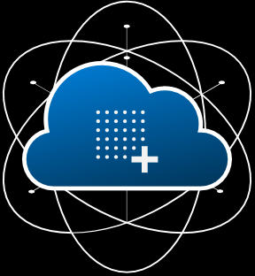
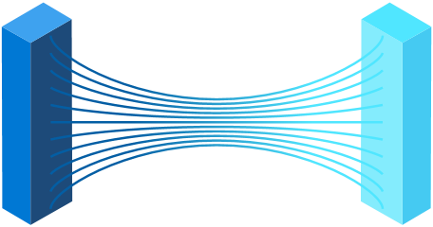
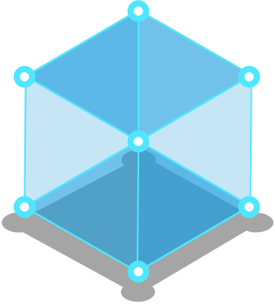
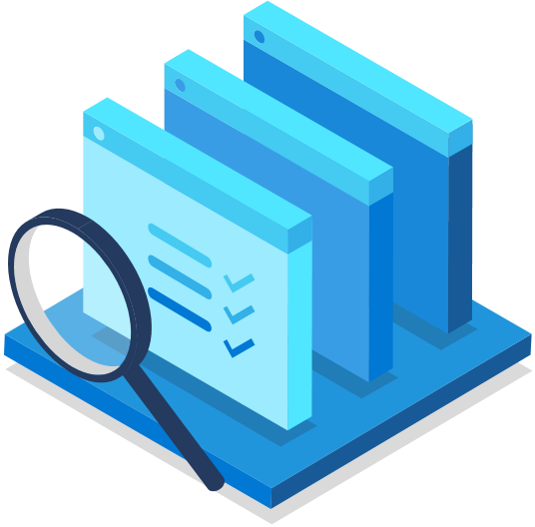

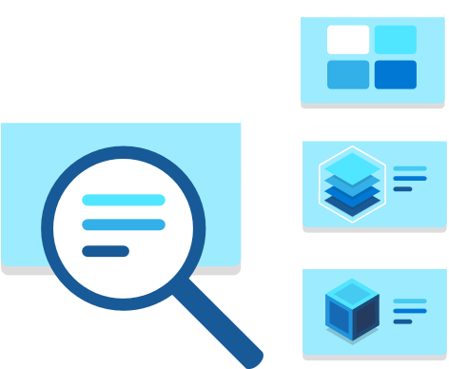
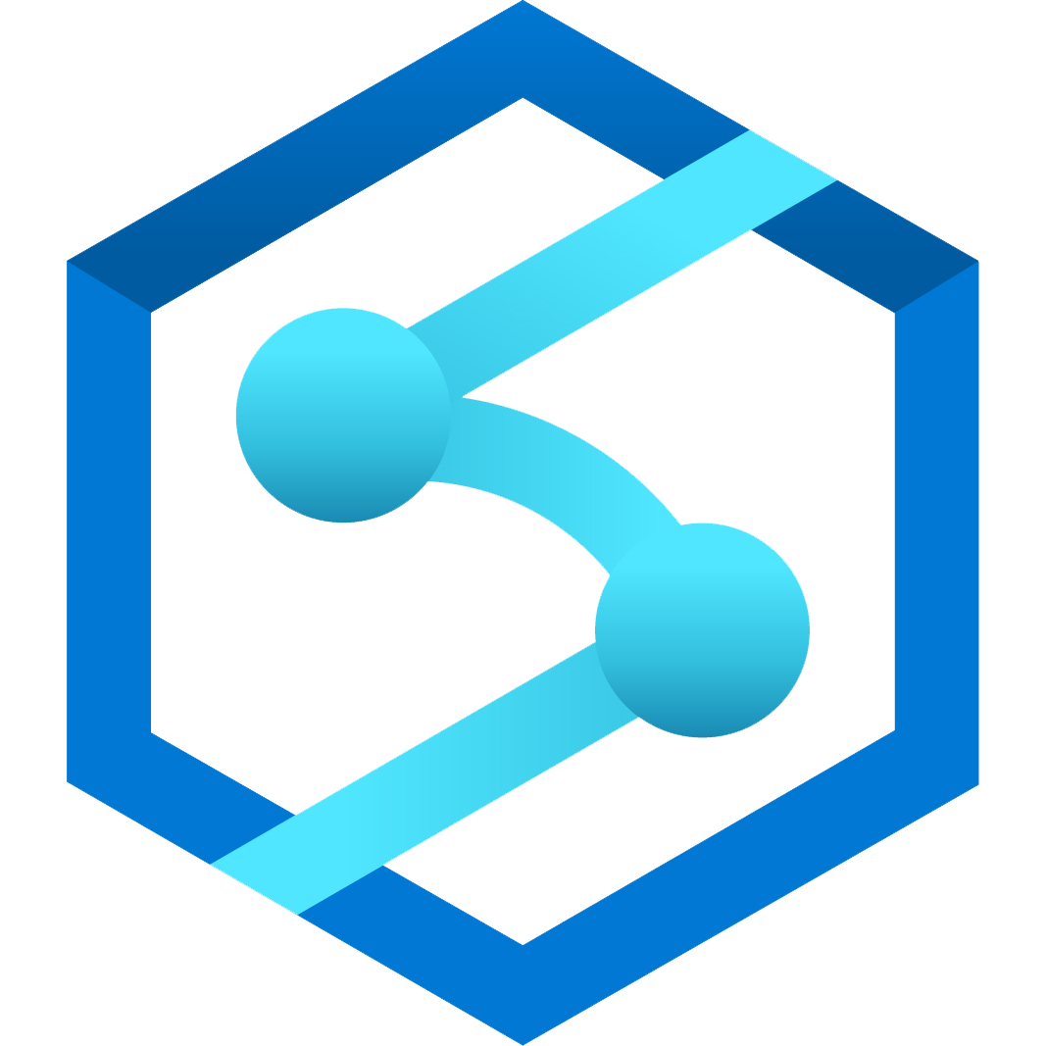
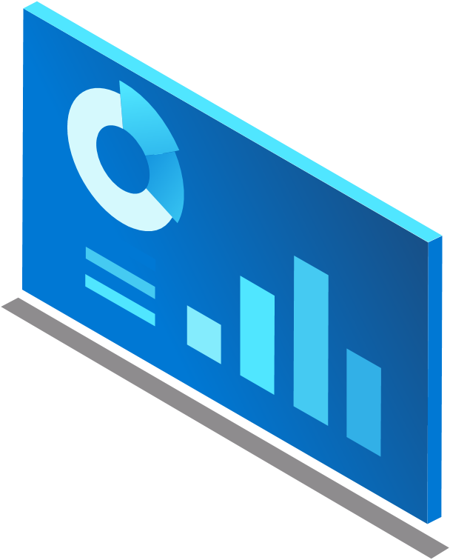
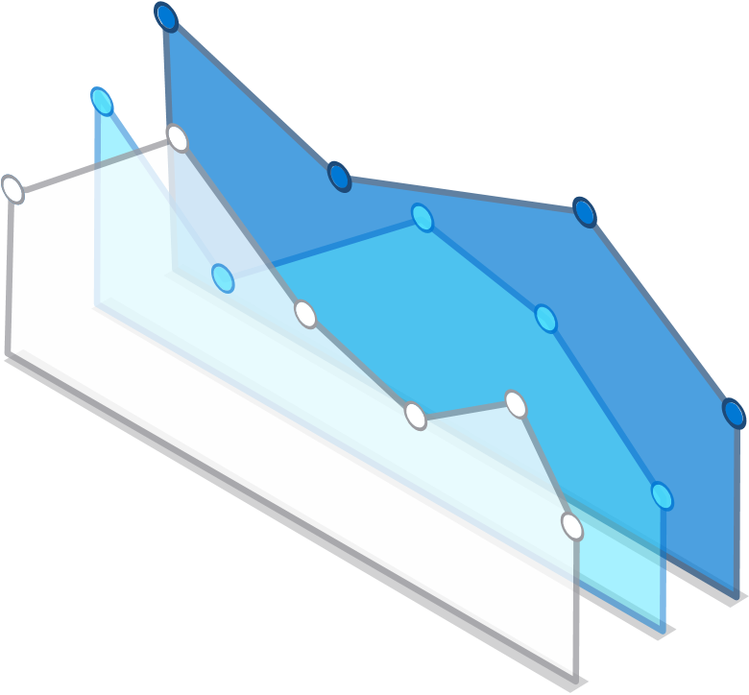
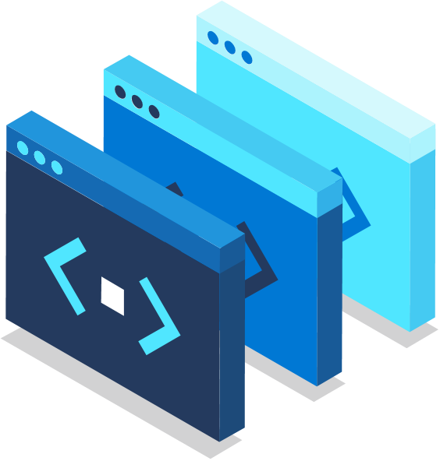
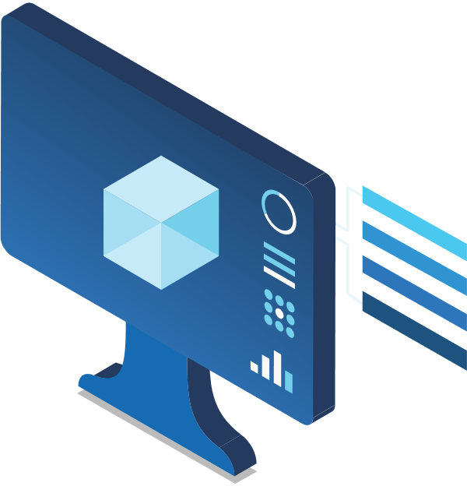
Azure Synapse data explorer
Distributed storage & query engine optimized for log & telemetry data

Slide 5

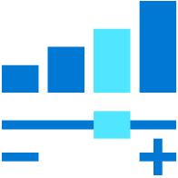
Key pillars of Azure Synapse Data Explorer
NEAR REAL-TIME INSIGHTS ON BIG DATA
OPTIMIZED ENGINE TO INTERACTIVELY QUERY ON LOG DATA
INTEGRATING CLOUD DATA PLATFORM FOR TIME SERIES AND IoT DATA
AUTOMATED SCALING FROM GIGABYTES TO PETABYTES

Slide 6

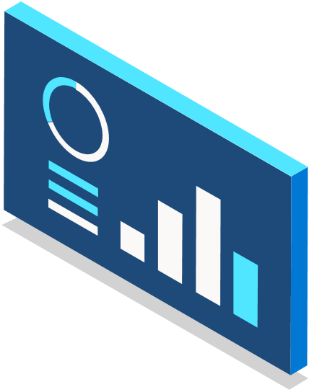
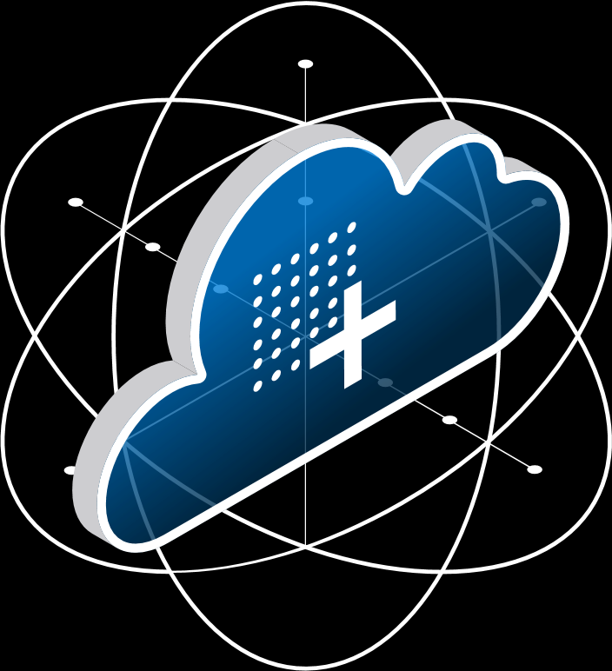
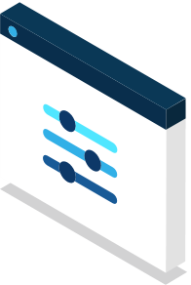
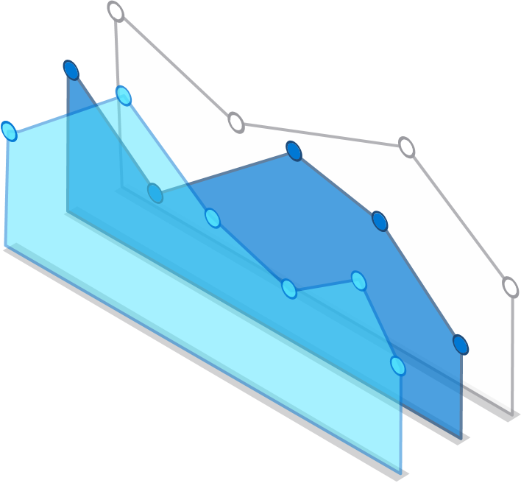
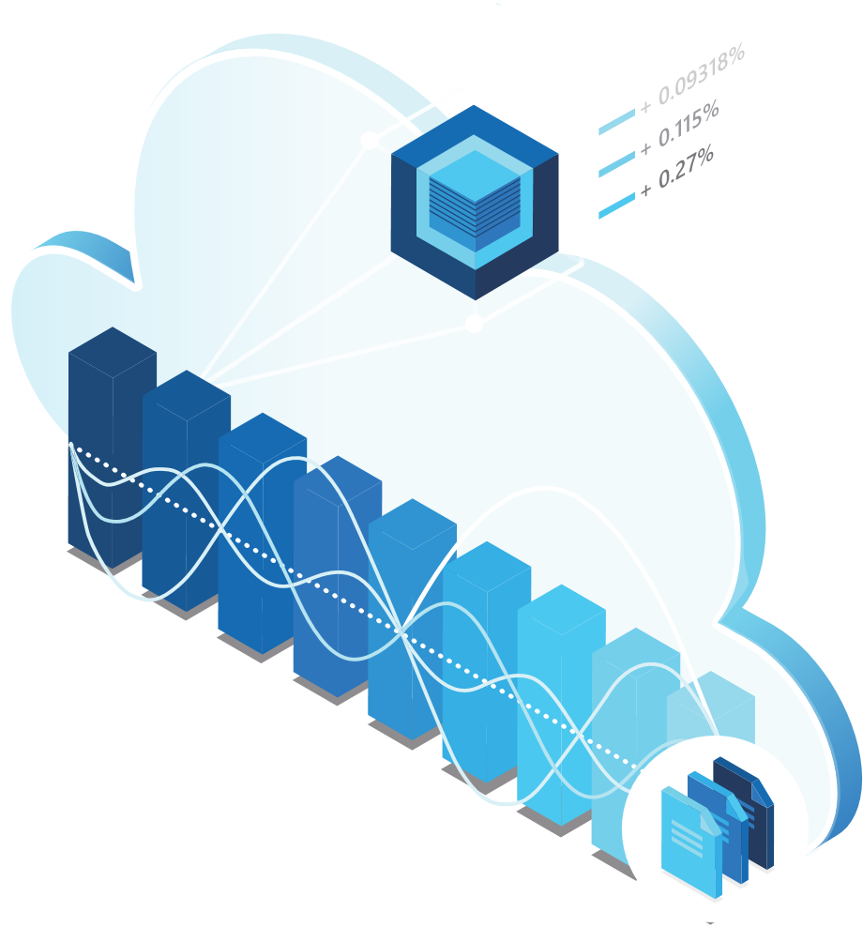
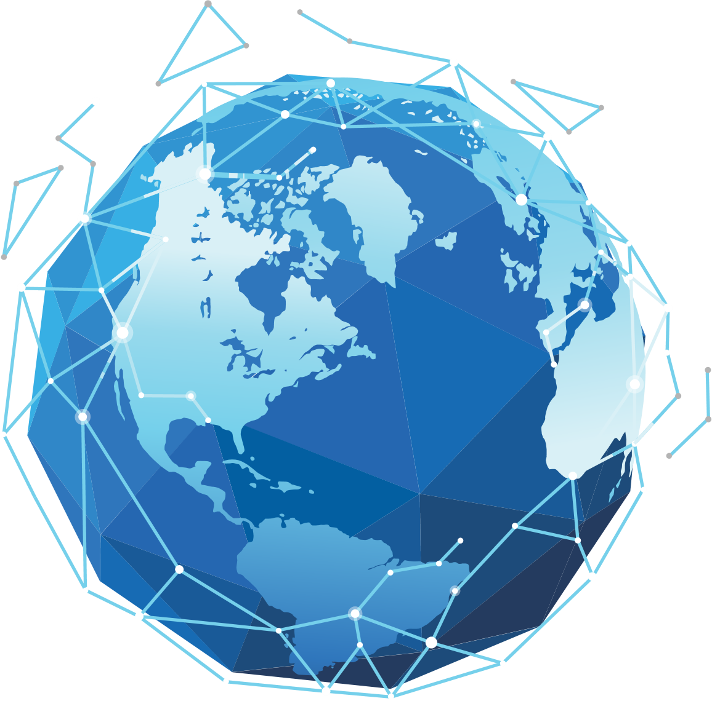
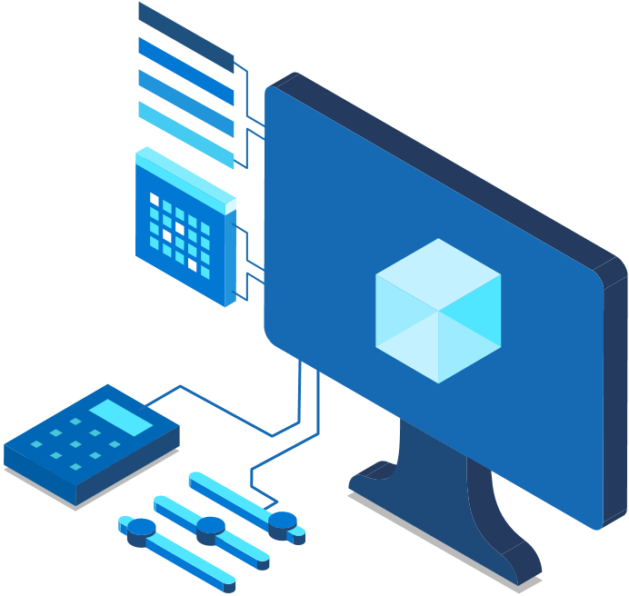


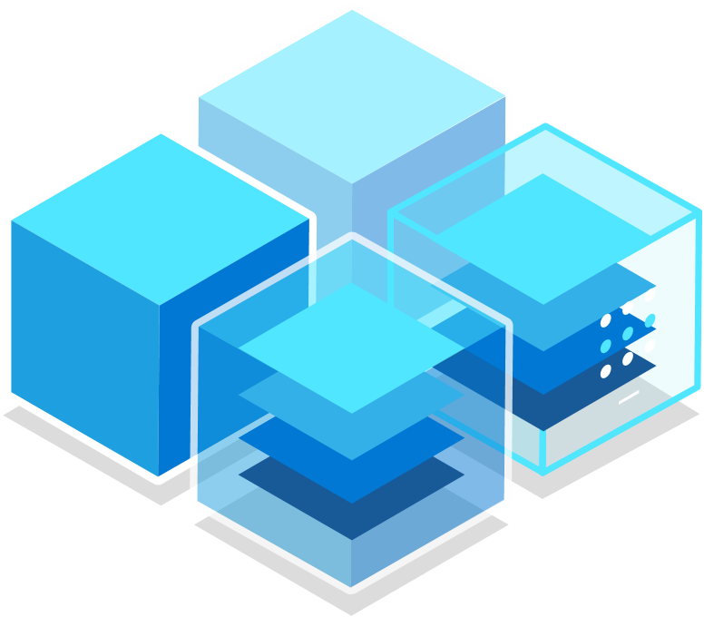
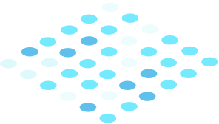
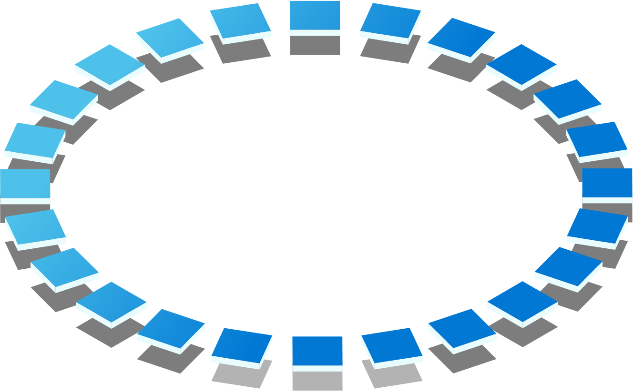
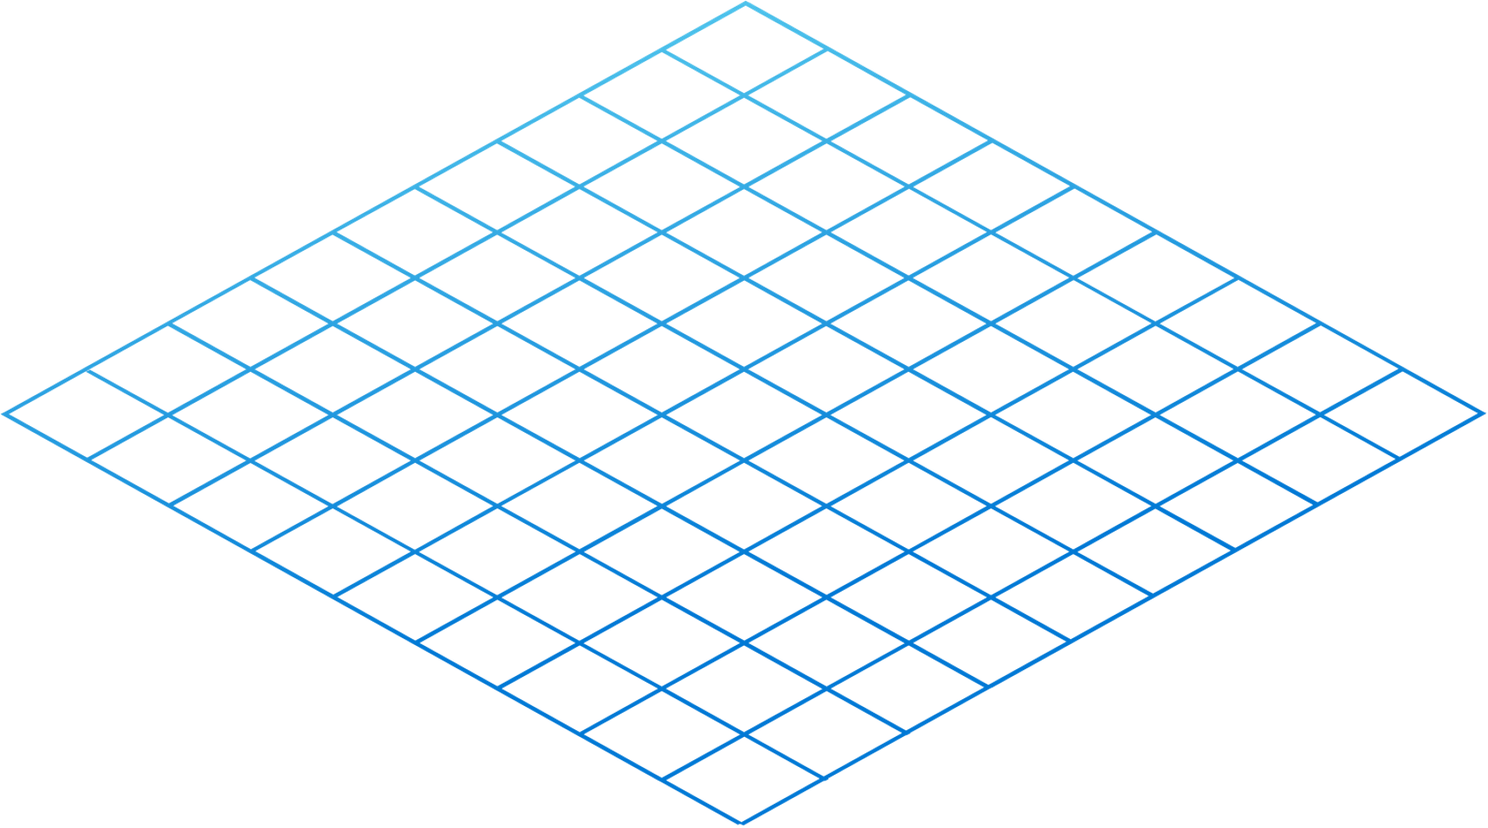
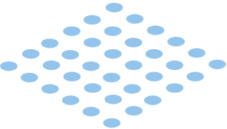
Technical Use Cases
1
Near-real time big data analytics solutions
Near-real time logs analytics solutions for your observability, monitoring, and security data
IoT Analytics solution
Analytical SaaS solutions

Slide 7
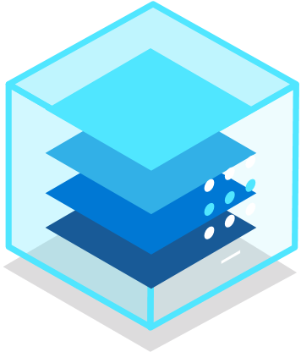



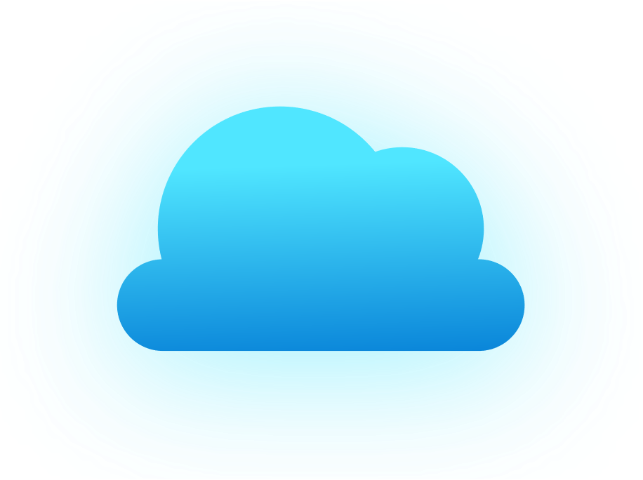
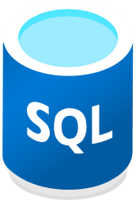
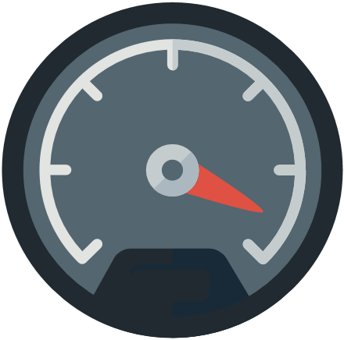
Data Explorer pool architecture
Azure
OSS
Applications
Azure portal/Studio
Apps (via ARM)
Apache Spark
Query, control commands
Create, manage
Azure Data Factory
Apps via APIs, REST, SQL (TDS), ODBC, JDBC)
Apps via APIs
Power BI
Data management
SSD
Logstash plugin
ADX UI (+ Dashboards)
Kafka sync
Power Automate, Flow
IoT Hub
Active data connections
Azure Data Factory
Event Hub
Jupyter Notebooks
Grafana, Redash.io
Event Grid
Apache Spark
Azure Storage
Customer Data Lake (blob / ADLS Gen2)
Ingested Data
SQL
Cosmos DB
Azure Monitor

Slide 8

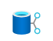






Run log & telemetry analytics seamlessly with Azure Synapse
Data Engineering - Data Warehousing - Data Science - Telemetry Analytics - Streaming Analytics - Intelligent Apps
Unified Experience
Azure Synapse Studio
On-prem
Integration
Management
Monitoring
Security
DevOps
Cloud data
Analytic runtimes
SQL
data explorer
Applications
Semantic Layer – Common Data Model
Streaming data
Data Warehouse
Data Lake
Event Brokers
Azure Synapse Link
Cosmos DB
Dataverse

Slide 9

12
Demo

Slide 10
Additional Resources
Getting started with Azure Synapse data explorer - Microsoft Tech Community
Azure Data Explorer | Microsoft Azure

Slide 11
Thank you!
Modern Analytics Academy “Vignettes”
Synapse Data Explorer
https://aka.ms/maa

